Slide 1


Supervised Learning II: Classification
13
PART III · MACHINE LEARNING CORE
CHAPTER 13 · WEEK 8
Data Science — From Foundations to Intelligent Systems
LECTURER
Dr. Mustafa Hameed
THE ISLAMIA UNIVERSITY OF BAHAWALPUR
Bahawalpur, Pakistan
Department of Information Technology · BSIT · Fall 2026
Notes:
Chapter 13: Supervised Learning II: Classification. Part 3 — Machine Learning Core. Week 8: Classification; evaluation (revision). Handout pages 82–87.

Slide 2

Where this chapter sits
THE COURSE
PART I
PART II
PART III
PART IV
PART V
PART VI
1
2
3
4
5
6
7
8
9
10
11
12
13
14
15
16
17
18
19
20
21
22
23
24
25
26
27
28
29
30
31
32
Supervised Learning II: Classification
BUILDS ON
USED LATER IN
Ch 4 The Mathematical Toolkit
Ch 14 Model Evaluation and Selection
Ch 6 Probability and Uncertainty
Ch 15 Feature Engineering and Ensembles
Ch 12 Supervised Learning I: Regression
Ch 20 Text and Natural Language Processing
Data Science · Chapter 13 · Supervised Learning II: Classification
Handout p. 82 2
Notes:
Place the chapter. Before you start: Chapter 6 (Bayes’ theorem, for naive Bayes), Chapter 4 (distance, for k-NN) and Chapter 12 (the linear score that logistic regression squashes). Revision note: surveys Machine Learning Fall 2026, Chapters 6 (Logistic Regression) and 9–12 (Decision Trees, Naive Bayes, k-NN, SVM).

Slide 3

What you will be able to do
LEARNING OUTCOMES
By the end of this chapter you will be able to:
1
Explain how logistic regression converts a linear score into a probability, and interpret its coefficients as odds ratios.
2
Describe the mechanism, strengths and weaknesses of k-NN, naive Bayes, decision trees and support vector machines.
3
Match a classifier to a problem’s constraints — data size, interpretability, training cost, feature types.
4
Interpret a decision boundary plot and relate its shape to model bias.
5
Explain why the default 0.5 threshold is a choice, not a law.
Data Science · Chapter 13 · Supervised Learning II: Classification
Handout p. 82 3
Notes:
Read these out: they are the chapter's contract with the room. Each click adds one.

Slide 4

Vocabulary for this chapter
KEY TERMS
classification
decision boundary
logistic (sigmoid) function
odds ratio
log loss
k-nearest neighbours
naive Bayes
decision tree
Gini impurity
entropy
support vector machine
margin
kernel
decision threshold
Each term is defined where it first matters — not here.
Data Science · Chapter 13 · Supervised Learning II: Classification
Handout p. 82 4
Notes:
Do not define these now; they arrive one at a time. This slide is for the students' notes. Terms: classification; decision boundary; logistic (sigmoid) function; odds ratio; log loss; k-nearest neighbours; naive Bayes; decision tree; Gini impurity; entropy; support vector machine; margin; kernel; decision threshold.

Slide 5
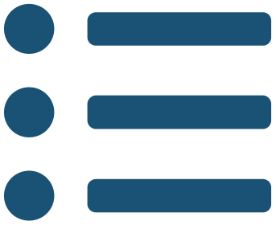
In this chapter
IN THIS CHAPTER
13.1
From Regression to Classification
p. 82 ›
13.2
Four More Classifiers
p. 83 ›
13.3
Decision Boundaries
p. 84 ›
13.4
The Threshold Is a Decision
p. 85 ›
Data Science · Chapter 13 · Supervised Learning II: Classification
Handout pp. 82–87 5
Notes:
The route through the chapter. Each row is a link: click it to jump to that section in the slide show.

Slide 6
From Regression to Classification
SECTION 1 OF 4
13.1
13.1 From Regression to Classification
13.2 Four More Classifiers
13.3 Decision Boundaries
13.4 The Threshold Is a Decision
Data Science · Chapter 13
Handout §13.1 6
Notes:
Pause. Name the question this section answers.

Slide 7

Logistic Regression
DEFINITION
Predict the positive class when p̂ exceeds a chosen threshold. Despite its name it is a classifier, not a regressor.
Data Science · Chapter 13 · Supervised Learning II: Classification
§13.1 · Handout p. 82 7
Notes:
Classification predicts a category, not a number. The natural first attempt — fit a straight line and threshold it — fails, because a line is unbounded and predicts probabilities above 1 and below 0. Logistic regression fixes this with one function.

Slide 8
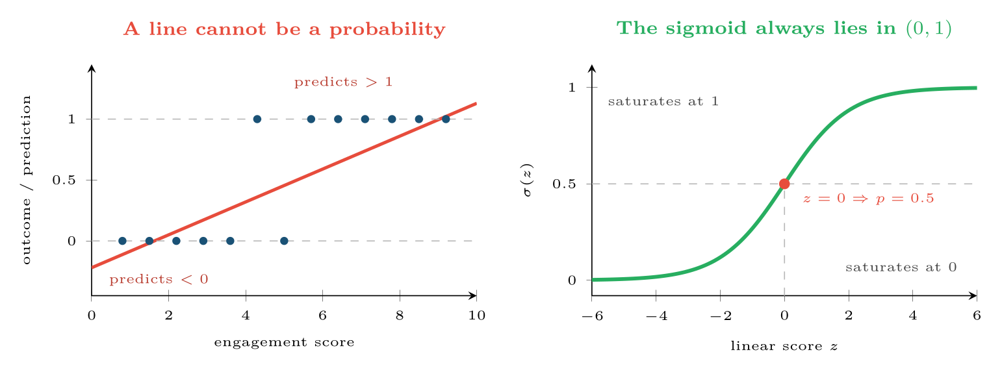
Why logistic regression exists
FIGURE 13.1
A linear fit to a 0/1 outcome produces impossible probabilities; the sigmoid maps any real score into a valid probability and saturates gracefully at both ends.
Data Science · Chapter 13 · Supervised Learning II: Classification
§13.1 · Handout p. 82 8
Notes:
Figure 13.1 (handout p. 83): Why logistic regression exists. A linear fit to a 0/1 outcome produces impossible probabilities; the sigmoid maps any real score into a valid probability and saturates gracefully at both ends.

Slide 9

Interpreting a Logistic Coefficient
WORKED EXAMPLE
A model predicting course failure returns
Step 1 — a concrete prediction. For a student with 60% attendance and 4 days absent:
About a 19.5% estimated probability of failing.
Step 2 — the odds ratio. Exponentiating a coefficient gives the multiplicative effect on the odds:
Data Science · Chapter 13 · Supervised Learning II: Classification
§13.1 · Handout p. 82 9
Notes:
Each click adds one step of the working. Ask for the next number before you reveal it.

Slide 10
Interpreting a Logistic Coefficient (continued)
WORKED EXAMPLE
Each additional day absent multiplies the odds of failing by 1.86 — an 86% increase in odds, holding attendance constant. This is how logistic models are reported in practice, because “the odds nearly double per day absent” is comprehensible in a way that “the log-odds rise by 0.62” is not.
Step 3 — the trap. Odds are not probability. Odds rising 86% moves a probability of 0.05 to 0.089, but a probability of 0.5 to 0.65. The same coefficient has a very different effect depending on where the student started.
Data Science · Chapter 13 · Supervised Learning II: Classification
§13.1 · Handout p. 82 10
Notes:
Each click adds one step of the working. Ask for the next number before you reveal it.

Slide 11
Four More Classifiers
SECTION 2 OF 4
13.2
13.1 From Regression to Classification
13.2 Four More Classifiers
13.3 Decision Boundaries
13.4 The Threshold Is a Decision
Data Science · Chapter 13
Handout §13.2 11
Notes:
Pause. Name the question this section answers.

Slide 12
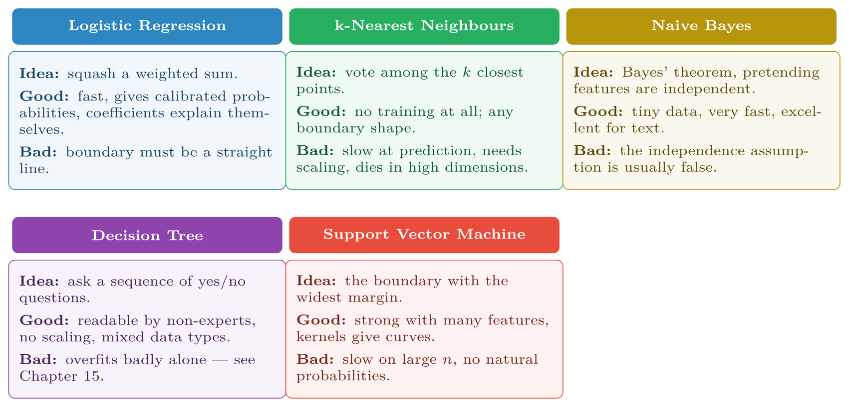
The five classical classifiers, with the trade-off that decides between them
FIGURE 13.2
There is no best one — Chapter 11’s no-free-lunch result in practical form.
Data Science · Chapter 13 · Supervised Learning II: Classification
§13.2 · Handout p. 83 12
Notes:
Figure 13.2 (handout p. 84): The five classical classifiers, with the trade-off that decides between them. There is no best one — Chapter 11’s no-free-lunch result in practical form.

Slide 13
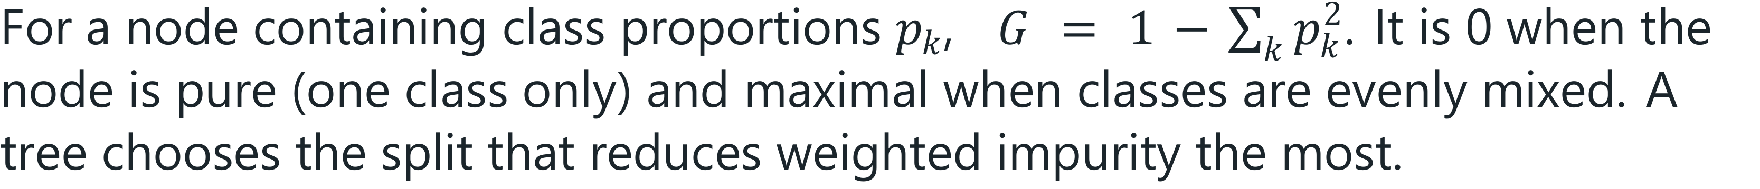
Gini Impurity
DEFINITION
Data Science · Chapter 13 · Supervised Learning II: Classification
§13.2.1 · Handout p. 83 13
Notes:
Read the box aloud, then ask for an example from the room before moving on.

Slide 14
Choosing a Split by Gini
WORKED EXAMPLE
100 students, 30 of whom failed. Root impurity:
Candidate split: attendance < 50%?
• Left (attendance <50): 25 students, 20 failed. G_{L} = 1 − (0.2² + 0.8²) = 1 − (0.04+0.64) = 0.32
• Right: 75 students, 10 failed. G_{R} = 1 − (0.867² + 0.133²) = 1 − (0.751+0.018) = 0.231
Weighted impurity: 25/100(0.32) + 75/100(0.231) = 0.08 + 0.173 = 0.253.
Gain: 0.42 − 0.253 = 0.167.
Candidate split: posted on forum? Left: 40 students, 14 failed, so G_{L} = 1−(0.35²+0.65²) = 0.455. Right: 60 students, 16 failed, so G_{R} = 1−(0.267²+0.733²) = 0.391. Weighted impurity 40/100(0.455) + 60/100(0.391) = 0.417, a gain of only 0.42 − 0.417 = 0.003.
The tree picks attendance, because it separates the classes far better. Repeat recursively on each child, and that is the entire algorithm.
Data Science · Chapter 13 · Supervised Learning II: Classification
§13.2.1 · Handout p. 83 14
Notes:
Each click adds one step of the working. Ask for the next number before you reveal it.

Slide 15
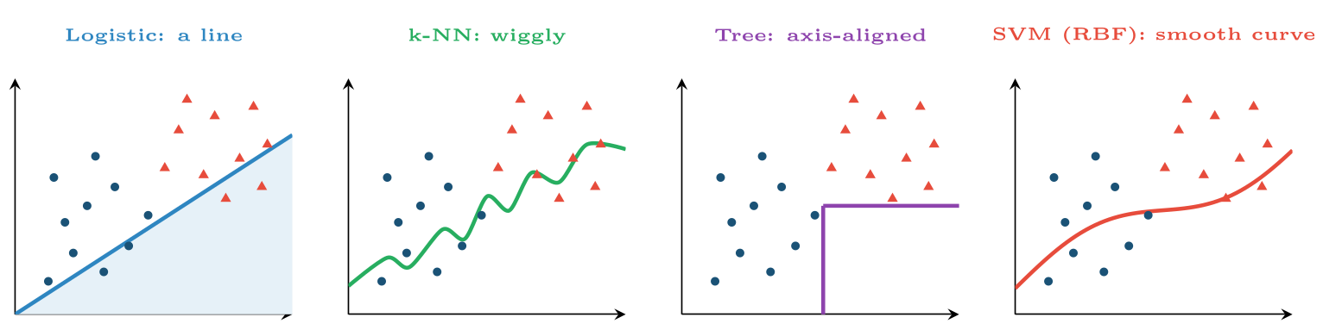
The same data, four boundary shapes
FIGURE 13.3
Logistic regression can only draw a line; a tree can only draw axis-parallel steps; k-NN and kernel SVMs can draw anything — which is powerful and is also how they overfit.
Data Science · Chapter 13 · Supervised Learning II: Classification
§13.3 · Handout p. 84 15
Notes:
The single most useful way to understand a classifier is to see the shape of boundary it is capable of drawing.
Figure 13.3 (handout p. 84): The same data, four boundary shapes. Logistic regression can only draw a line; a tree can only draw axis-parallel steps; k-NN and kernel SVMs can draw anything — which is powerful and is also how they overfit.

Slide 16
The Threshold Is a Decision
SECTION 4 OF 4
13.4
13.1 From Regression to Classification
13.2 Four More Classifiers
13.3 Decision Boundaries
13.4 The Threshold Is a Decision
Data Science · Chapter 13
Handout §13.4 16
Notes:
Pause. Name the question this section answers.

Slide 17

0.5 Is Not Sacred
WATCH OUT
Predicting “positive when p̂ > 0.5” is a default, not a requirement. Lower the threshold and you catch more true positives at the cost of more false alarms; raise it and the reverse. On imbalanced problems the default is almost always wrong. Chapter 14 shows how to choose the threshold from the cost of each error type — and that is where this chapter’s models actually become usable.
Data Science · Chapter 13 · Supervised Learning II: Classification
§13.4 · Handout p. 85 17
Notes:
Read the box aloud, then ask for an example from the room before moving on.

Slide 18

The Threshold Is a Decision
AT A GLANCE
Model | Train speed | Predict speed | Explainable? | Reach for it when
Logistic regression | Fast | Very fast | Yes — odds ratios | You must justify decisions to people
k-NN | Instant (none) | Slow | Partly | Small data, odd boundary shapes
Naive Bayes | Very fast | Very fast | Partly | Text, tiny data, a strong baseline
Decision tree | Fast | Very fast | Yes — readable rules | Mixed types, rules must be auditable
SVM (RBF) | Slow on big n | Moderate | No | Many features, moderate n, accuracy over clarity
Data Science · Chapter 13 · Supervised Learning II: Classification
§13.4 · Handout p. 85 18
Notes:
Do not read the table row by row: pick the row the room is most likely to get wrong and ask why.

Slide 19

Common pitfalls
COMMON PITFALLS
✕
Using k-NN without scaling. The largest-range feature becomes the only feature (Chapter 4).
✕
Believing naive Bayes’ probabilities. Its ranking is often good; its probabilities are usually badly calibrated because the independence assumption is false.
✕
Deploying a single unpruned tree. It will memorise the training set. Use depth limits, or the ensembles of Chapter 15.
✕
Reading logistic coefficients as probabilities. They are log-odds; exponentiate them for odds ratios.
Data Science · Chapter 13 · Supervised Learning II: Classification
§13.4 · Handout p. 85 19
Notes:
For each pitfall, ask who has seen it happen. One real story beats five bullets.

Slide 20





Four lenses: Choosing a Classifier
FOUR LENSES
LEARNING ANALYTICS
PROJECT MANAGEMENT
Use logistic regression or a shallow tree, even at some cost in accuracy.
With 40 sprints of history, naive Bayes or a depth-2 tree is the honest choice.
INTERNET OF THINGS
CYBERSECURITY
At the edge, prediction cost is a hard constraint: a device with a microcontroller cannot run k-NN against a million stored points.
Naive Bayes remains a strong, fast baseline for phishing and spam because text features are numerous and the speed matters at mail-gateway volumes.
Data Science · Chapter 13 · Supervised Learning II: Classification
Handout p. 87 20
Notes:
The same method, four domains. Each of the next four slides opens one lens in full.

Slide 21

Learning Analytics: Choosing a Classifier
FOUR LENSES
LEARNING ANALYTICS
Project Management
Use logistic regression or a shallow tree, even at some cost in accuracy. A model that flags a student for intervention must be explainable to that student and to the appeals process — “you were flagged because attendance below 50% and two missed labs” is defensible; “the SVM said so” is not. This is a requirement from Chapter 28, not a preference.
Internet of Things
Cybersecurity
Data Science · Chapter 13 · Supervised Learning II: Classification
Handout p. 87 21
Notes:
Learning Analytics. Use logistic regression or a shallow tree, even at some cost in accuracy. A model that flags a student for intervention must be explainable to that student and to the appeals process — “you were flagged because attendance below 50% and two missed labs” is defensible; “the SVM said so” is not. This is a requirement from Chapter 28, not a preference.

Slide 22

Project Management: Choosing a Classifier
FOUR LENSES
PROJECT MANAGEMENT
Learning Analytics
With 40 sprints of history, naive Bayes or a depth-2 tree is the honest choice. Anything more flexible will fit noise. A two-rule tree that a scrum master can read out in a stand-up will actually change behaviour, which is the point — a marginally better black box that nobody trusts changes nothing.
Internet of Things
Cybersecurity
Data Science · Chapter 13 · Supervised Learning II: Classification
Handout p. 87 22
Notes:
Project Management. With 40 sprints of history, naive Bayes or a depth-2 tree is the honest choice. Anything more flexible will fit noise. A two-rule tree that a scrum master can read out in a stand-up will actually change behaviour, which is the point — a marginally better black box that nobody trusts changes nothing.

Slide 23

Internet of Things: Choosing a Classifier
FOUR LENSES
INTERNET OF THINGS
Learning Analytics
At the edge, prediction cost is a hard constraint: a device with a microcontroller cannot run k-NN against a million stored points. Logistic regression or a small tree fits in kilobytes and predicts in microseconds. Train something heavy in the cloud, then distil or replace it with something small enough to deploy (Chapter 24).
Project Management
Cybersecurity
Data Science · Chapter 13 · Supervised Learning II: Classification
Handout p. 87 23
Notes:
Internet of Things. At the edge, prediction cost is a hard constraint: a device with a microcontroller cannot run k-NN against a million stored points. Logistic regression or a small tree fits in kilobytes and predicts in microseconds. Train something heavy in the cloud, then distil or replace it with something small enough to deploy (Chapter 24).

Slide 24

Cybersecurity: Choosing a Classifier
FOUR LENSES
CYBERSECURITY
Learning Analytics
Naive Bayes remains a strong, fast baseline for phishing and spam because text features are numerous and the speed matters at mail-gateway volumes. For intrusion detection, tree ensembles dominate — but note that an interpretable model has a specific operational value here: an analyst must be able to explain to an incident review why a session was blocked. Also, a k-NN boundary that hugs training data is trivially evaded by an adversary who probes it.
Project Management
Internet of Things
Data Science · Chapter 13 · Supervised Learning II: Classification
Handout p. 87 24
Notes:
Cybersecurity. Naive Bayes remains a strong, fast baseline for phishing and spam because text features are numerous and the speed matters at mail-gateway volumes. For intrusion detection, tree ensembles dominate — but note that an interpretable model has a specific operational value here: an analyst must be able to explain to an incident review why a session was blocked. Also, a k-NN boundary that hugs training data is trivially evaded by an adversary who probes it.

Slide 25

Try it yourself: Five Classifiers, One Comparison
TRY IT YOURSELF
WHAT YOU WILL DO
1. The tree's great advantage: you can read it out loud
2. Logistic coefficients as odds ratios
THIS WEEK'S LAB
WHAT YOU WILL RUN
Week 8: Five classifiers; evaluate honestly
1 listing, 31 lines of Python
Data Science · Chapter 13 · Supervised Learning II: Classification
§13.4 · Handout p. 85 25
Notes:
Say what the room will have at the end of the lab, then let them start. Circulate rather than lecture.

Slide 26
Five Classifiers, One Comparison
LAB · STEP 1 OF 4
Set-up
Python
1
2
3
4
5
6
7
8
9
10
11
12
13
14
15
16
17
18
import numpy as np
from sklearn.linear_model import LogisticRegression
from sklearn.neighbors import KNeighborsClassifier
from sklearn.naive_bayes import GaussianNB
from sklearn.tree import DecisionTreeClassifier, export_text
from sklearn.svm import SVC
from sklearn.pipeline import make_pipeline
from sklearn.preprocessing import StandardScaler
from sklearn.model_selection import cross_val_score
models = {
# scaling matters for the distance/margin-based models
"logistic": make_pipeline(StandardScaler(), LogisticRegression(max_iter=1000)),
"k-NN (k=5)": make_pipeline(StandardScaler(), KNeighborsClassifier(5)),
"naive Bayes": GaussianNB(),
"tree (d=3)": DecisionTreeClassifier(max_depth=3, random_state=0),
"SVM (RBF)": make_pipeline(StandardScaler(), SVC()),
}
Data Science · Chapter 13 · Supervised Learning II: Classification
§13.4 · Handout p. 85 26
Notes:
Step 1: Set-up. Read the code aloud; ask what each line would print before running it.

Slide 27
Five Classifiers, One Comparison
LAB · STEP 2 OF 4
Python
19
20
21
for name, m in models.items():
s = cross_val_score(m, X_tr, y_tr, cv=5, scoring="roc_auc")
print(f"{name:12s} AUC {s.mean():.3f} +/- {s.std():.3f}")
Data Science · Chapter 13 · Supervised Learning II: Classification
§13.4 · Handout p. 85 27
Notes:
Read the code aloud; ask what each line would print before running it.

Slide 28
Five Classifiers, One Comparison
LAB · STEP 3 OF 4
The tree's great advantage: you can read it out loud
Python
22
23
24
# --- the tree's great advantage: you can read it out loud -------------
tree = DecisionTreeClassifier(max_depth=3).fit(X_tr, y_tr)
print(export_text(tree, feature_names=list(feature_names)))
Data Science · Chapter 13 · Supervised Learning II: Classification
§13.4 · Handout p. 85 28
Notes:
Step 3: The tree's great advantage: you can read it out loud. Read the code aloud; ask what each line would print before running it.

Slide 29
Five Classifiers, One Comparison
LAB · STEP 4 OF 4
Logistic coefficients as odds ratios
Python
25
26
27
28
# --- logistic coefficients as odds ratios -----------------------------
lr = make_pipeline(StandardScaler(), LogisticRegression(max_iter=1000)).fit(X_tr, y_tr)
for f, c in zip(feature_names, lr[-1].coef_[0]):
print(f" {f:22s} log-odds {c:+.3f} odds ratio {np.exp(c):.2f}")
Data Science · Chapter 13 · Supervised Learning II: Classification
§13.4 · Handout p. 85 29
Notes:
Step 4: Logistic coefficients as odds ratios. Read the code aloud; ask what each line would print before running it.

Slide 30

A logistic model has coefficient +1.1 on a feature. What is the odds ratio, and what does it mean in words?
CHECKPOINT 1 OF 3
Discuss with the person next to you, then advance.
Data Science · Chapter 13 · Supervised Learning II: Classification
Handout p. 87 · answers in Appendix D 30
Notes:
Ask the room. Do not advance until someone commits to an answer.

Slide 31

A logistic model has coefficient +1.1 on a feature. What is the odds ratio, and what does it mean in words?
CHECKPOINT 1 OF 3 · ANSWER
e^{1.1} ≈ 3.0. Each one-unit increase in the feature multiplies the odds of the positive class by about three, holding the other features constant.
Data Science · Chapter 13 · Supervised Learning II: Classification
Handout p. 87 · answers in Appendix D 31
Notes:
Answer (Appendix D): e1.1 ≈ 3.0. Each one-unit increase in the feature multiplies the odds of the positive class by about three, holding the other features constant.

Slide 32
Why does k-NN require feature scaling while a decision tree does not?
CHECKPOINT 2 OF 3
Discuss with the person next to you, then advance.
Data Science · Chapter 13 · Supervised Learning II: Classification
Handout p. 87 · answers in Appendix D 32
Notes:
Ask the room. Do not advance until someone commits to an answer.

Slide 33
Why does k-NN require feature scaling while a decision tree does not?
CHECKPOINT 2 OF 3 · ANSWER
k-NN computes distances, so the feature with the largest numeric range dominates them. A tree splits on one feature at a time and only compares values within that feature, so its units are irrelevant.
Data Science · Chapter 13 · Supervised Learning II: Classification
Handout p. 87 · answers in Appendix D 33
Notes:
Answer (Appendix D): k-NN computes distances, so the feature with the largest numeric range dominates them. A tree splits on one feature at a time and only compares values within that feature, so its units are irrelevant.

Slide 34
A node contains 40 samples: 40 positive, 0 negative. What is its Gini impurity, and what will the tree do next?
CHECKPOINT 3 OF 3
Discuss with the person next to you, then advance.
Data Science · Chapter 13 · Supervised Learning II: Classification
Handout p. 87 · answers in Appendix D 34
Notes:
Ask the room. Do not advance until someone commits to an answer.

Slide 35
A node contains 40 samples: 40 positive, 0 negative. What is its Gini impurity, and what will the tree do next?
CHECKPOINT 3 OF 3 · ANSWER
G = 1 − (1² + 0²) = 0. The node is pure, so the tree stops splitting it and makes it a leaf.
Data Science · Chapter 13 · Supervised Learning II: Classification
Handout p. 87 · answers in Appendix D 35
Notes:
Answer (Appendix D): G = 1 − (12 + 02) = 0. The node is pure, so the tree stops splitting it and makes it a leaf.

Slide 36

What to take away
CHAPTER SUMMARY
1
Logistic regression squashes a linear score through a sigmoid to produce a probability; e^{w}_{j} is the odds ratio for feature j.
2
k-NN needs no training but is slow, scale-sensitive and degrades in high dimensions.
3
Naive Bayes assumes feature independence — usually false, yet often effective, especially on text.
4
Trees split to reduce Gini impurity, are readable, need no scaling, and overfit badly if unconstrained.
5
SVMs maximise the margin and can draw curved boundaries via kernels, at the cost of interpretability and training speed.
6
Boundary shape is the key intuition: linear, axis-parallel, or arbitrary.
7
The 0.5 threshold is a default to be revisited in Chapter 14.
Data Science · Chapter 13 · Supervised Learning II: Classification
Handout p. 87 36
Notes:
Ask the room to say each takeaway before you reveal it.

Slide 37

Quick check 1 of 2
REVIEW · MULTIPLE CHOICE
The sigmoid function maps a real number into:
A
[−1,1]
B
(0,1)
C
[0,∞)
D
{0,1}
Data Science · Chapter 13 · Supervised Learning II: Classification
Handout p. 87 37
Notes:
Take a show of hands for each option before discussing. (The handout does not print MCQ answers.)

Slide 38
Quick check 2 of 2
REVIEW · MULTIPLE CHOICE
Which classifier produces a boundary made only of axis-parallel segments?
A
Logistic regression
B
k-NN
C
Decision tree
D
RBF SVM
Data Science · Chapter 13 · Supervised Learning II: Classification
Handout p. 87 38
Notes:
Take a show of hands for each option before discussing. (The handout does not print MCQ answers.)

Slide 39
For your notebook
REVIEW QUESTIONS
SHORT
Explain what “naive” refers to in naive Bayes and give an example where the assumption clearly fails.
SHORT
A logistic coefficient is −0.35. Compute the odds ratio and interpret it.
SHORT
Why is a single deep decision tree a poor production model, and what does Chapter 15 do about it?
APPLIED
Compute the Gini impurity of a node with 60 samples, 45 of class A and 15 of class B. Then compute the weighted impurity of a split producing children of (30: 28A/2B) and (30: 17A/13B), and state the gain.
APPLIED
For each of the four running domains, choose a classifier and defend the choice in two sentences, referring to at least one constraint that is not accuracy.
Data Science · Chapter 13 · Supervised Learning II: Classification
Handout p. 87 39
Notes:
Set these for independent study. Model answers are not printed in the handout.

Slide 40
End of Chapter 13
13
NEXT
READ
Chapter 14 — Model Evaluation and Selection
Handout Chapter 13, pages 82–87
THIS WEEK'S LAB
Five classifiers; evaluate honestly
Data Science · Chapter 13 · Supervised Learning II: Classification
40
Notes:
Close. NEXT: Chapter 14 — Model Evaluation and Selection. READ: Handout Chapter 13, pages 82–87. THIS WEEK'S LAB: Five classifiers; evaluate honestly.

